Slide 1
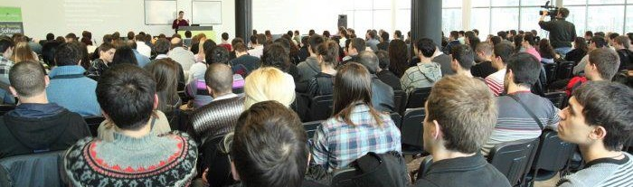


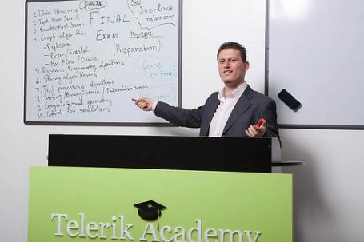

Quick Presentations
Guidelines to Preparing and Delivering an Elevator Pitch Presentation
Svetlin Nakov
Manager Technical Training
www.nakov.com
Telerik Software Academy
academy.telerik.com

Slide 2

Table of Contents
What is an “Elevator Pitch” Talk?
Very Limited in Time
Preparation
Creating Slides, Demos, etc.
Delivery
Structure: Opening, Talk, Closing, Questions
Live Demonstrations
Body Language: Position, Voice, Dressing
The Most Important: Rehearsals

Slide 3
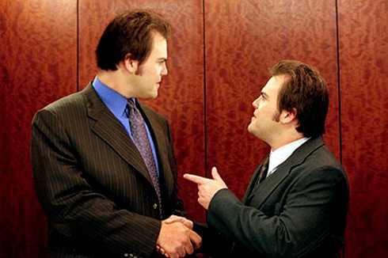



What is an “Elevator Pitch” Talk?
Very limited in time!
90 seconds
3-5 minutes
To shortly present:
Problem, Solution, Potential, Team, …
A great chance!

Slide 4






Preparation
Create slides
90 seconds = 3-4 slides
Prepare demos
Screenshots
Preloaded browser
Test the equipment
The most important: rehearsals

Slide 5





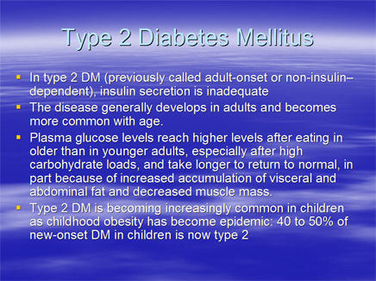

Creating Slides
Fonts
Prefer
Less text
Colors
More images
Bad slide
Good slide

Slide 6
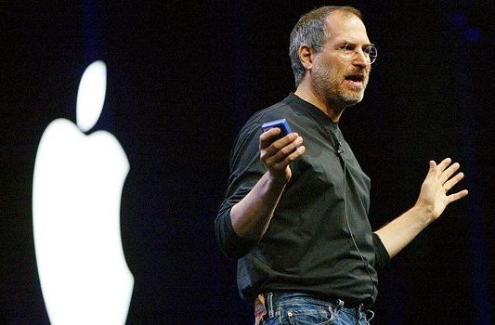



Delivery
Structure
Demos
Body language

Slide 7






Structure
Opening
Main talk
Demos
Closing
Questions

Slide 8





Live Demos
Quick
Impressive
Interesting scenario

Slide 9

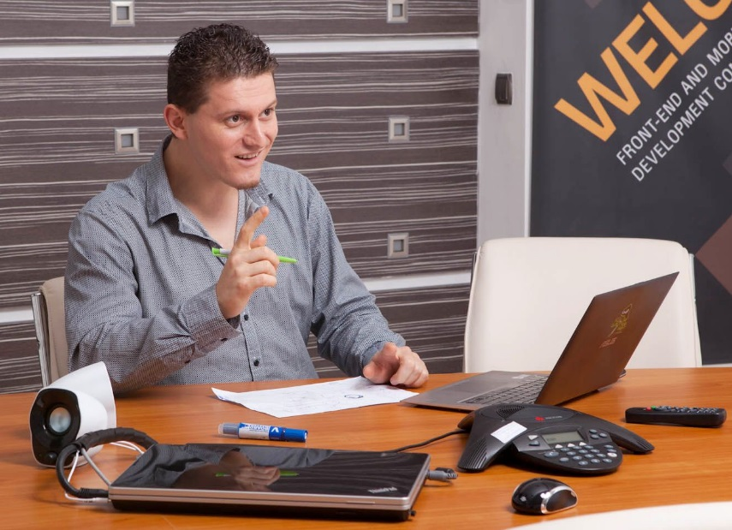



Body Language
Position
Straight
Confidence
Voice
Volume, tempo, intonation, timbre
Gestures
Dressing

Slide 10
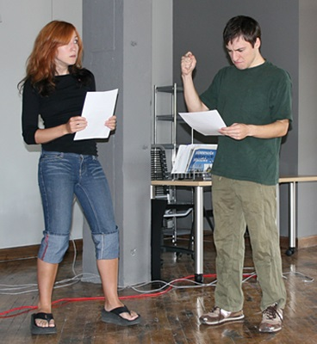



Rehearsals!
Rehearse, rehearse, rehearse!
Find listeners
Get feedback
Improve yourself

Slide 11
Quick Presentations
http://academy.telerik.com

Slide 12



Free Trainings @ Telerik Academy
"Web Design with HTML 5, CSS 3 and JavaScript" course @ Telerik Academy
html5course.telerik.com
Telerik Software Academy
academy.telerik.com
Telerik Academy @ Facebook
facebook.com/TelerikAcademy
Telerik Software Academy Forums
forums.academy.telerik.com

